Slide 1
[WIP] NF Results
Last updated: 04/05/2024

Slide 2
Problem
Neurofilament-derived brush comprised of one or more of:
Light (156 residues) sidearm
Medium (438 residues) sidearm
Heavy (647 residues) sidearm
Response to ionic strength characterized by brush height measured through AFM
Question: role of each sidearm on overall morphology of brush and translation to biological neurofilaments

Slide 3
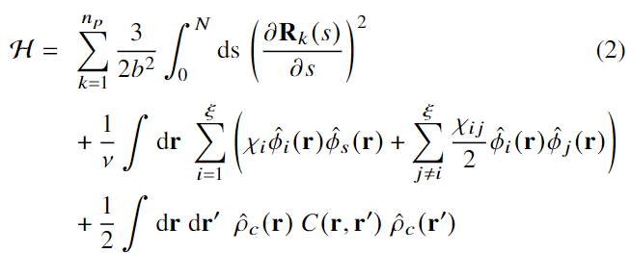
Model
Interactions
Self-consistent field theory for charged multiblock macromolecules
Coupled system of 5 algebraic equations and 2 partial differential equations
Elastic energy
Flory-Huggins (Hydrophobicity)
Electrostatics

Slide 4
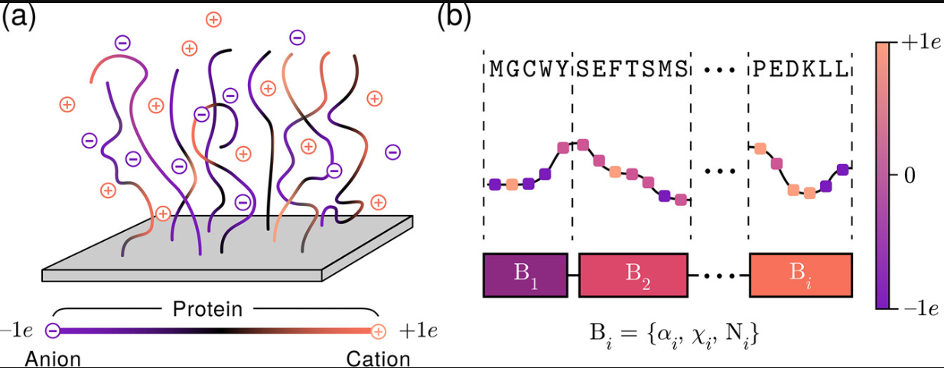
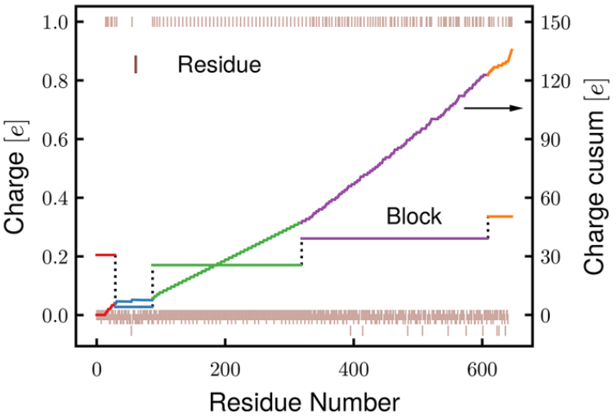
Treatment of Sequences
Protein → Multiblock charged macromolecular model
Coarse-graining by grouping similar neighboring charges (cusum method)
Yokokura et al. Biomacromolecules. 2024

Slide 5
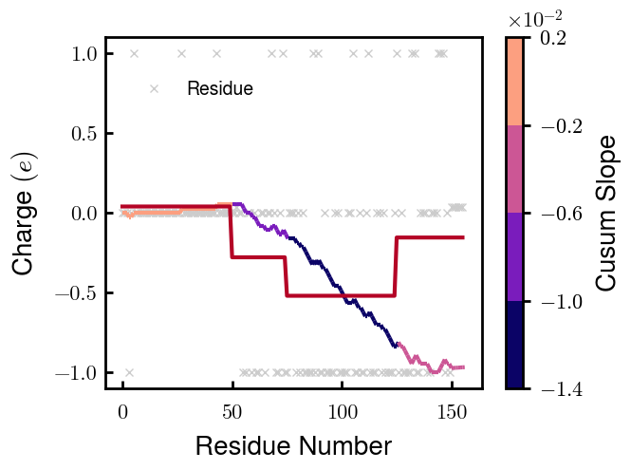
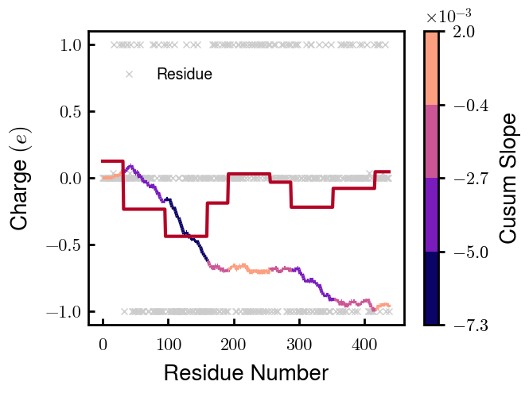
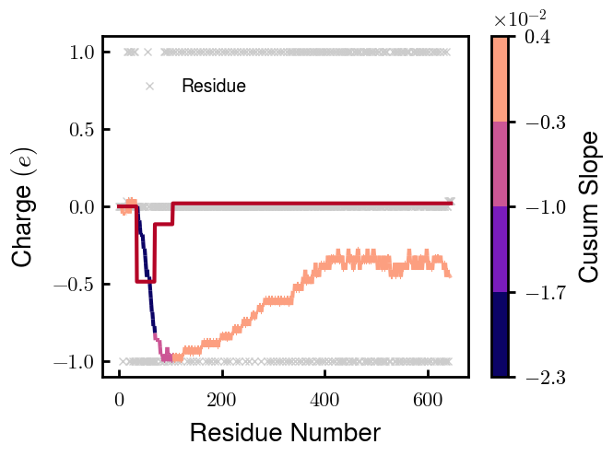
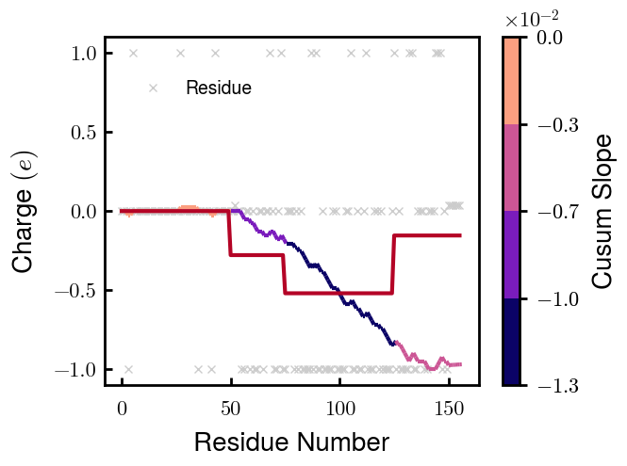
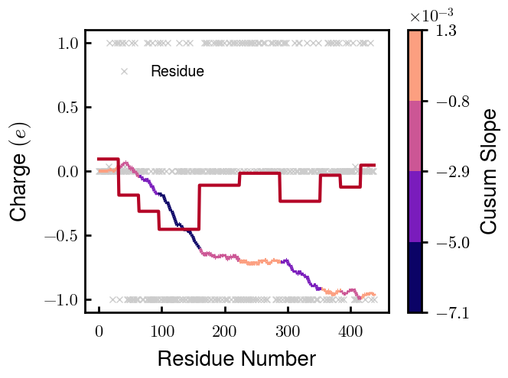
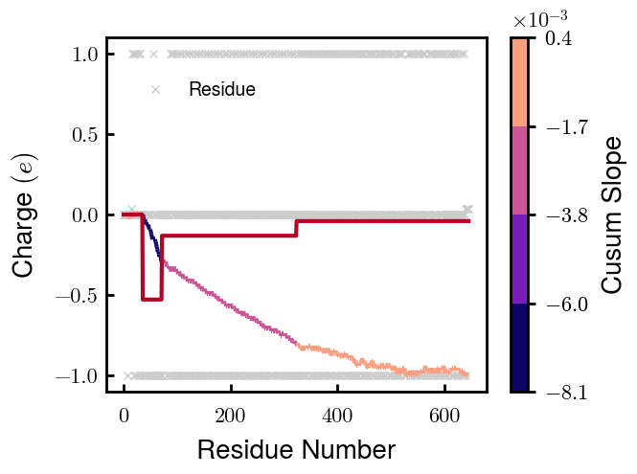
Coarse-grained Distributions (1 of 2)
NFL
NFM
NFH
Non-phospho
Phospho
Note: phospho $=−1e$ chosen for best agreement with experimentally measured heights

Slide 6
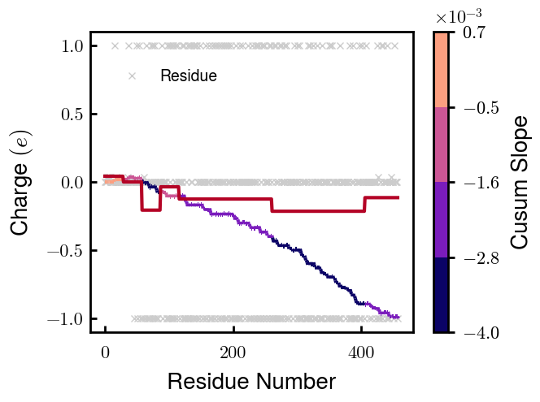
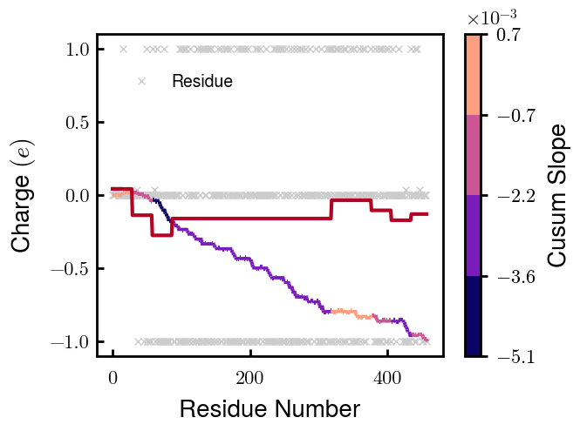
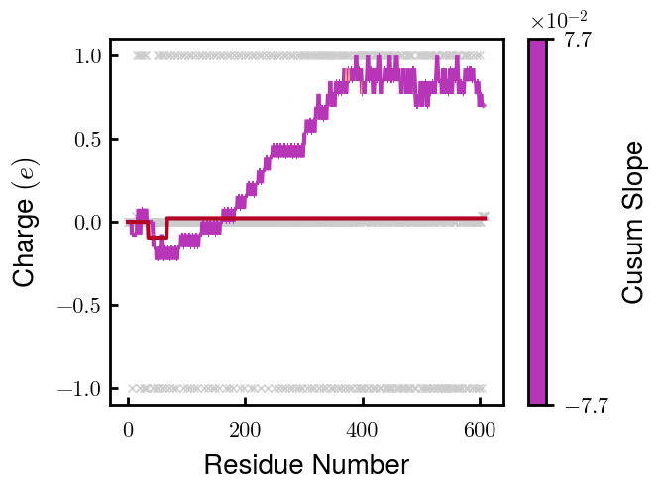
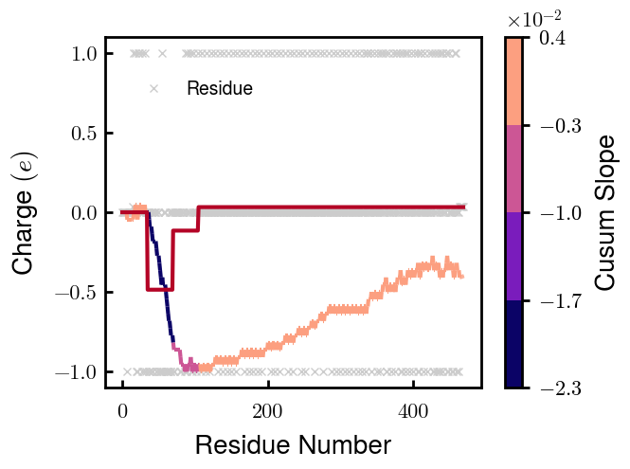
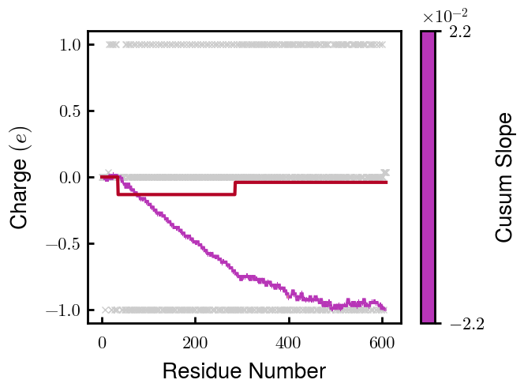
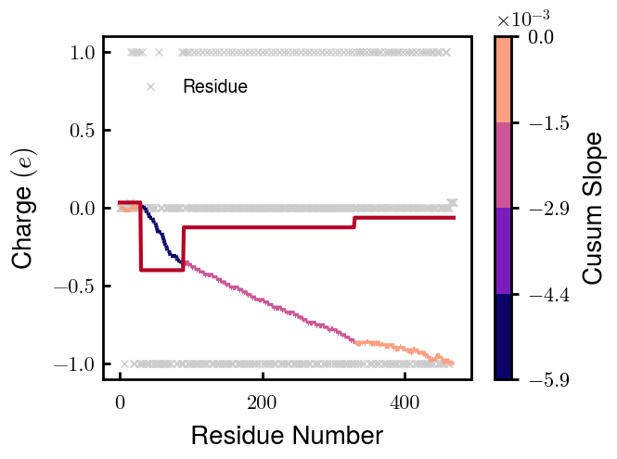
Coarse-grained Distributions (2 of 2)
NFM S1
NFM S2
NFH D2
NFH D6
Non-phospho
Phospho
—
—
Note: phospho $=−1e$ chosen for best agreement with experimentally measured heights

Slide 7
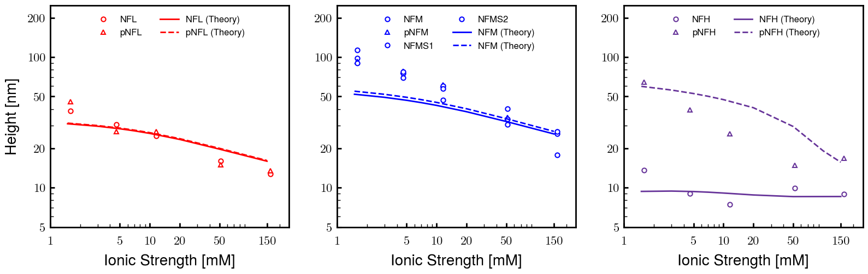
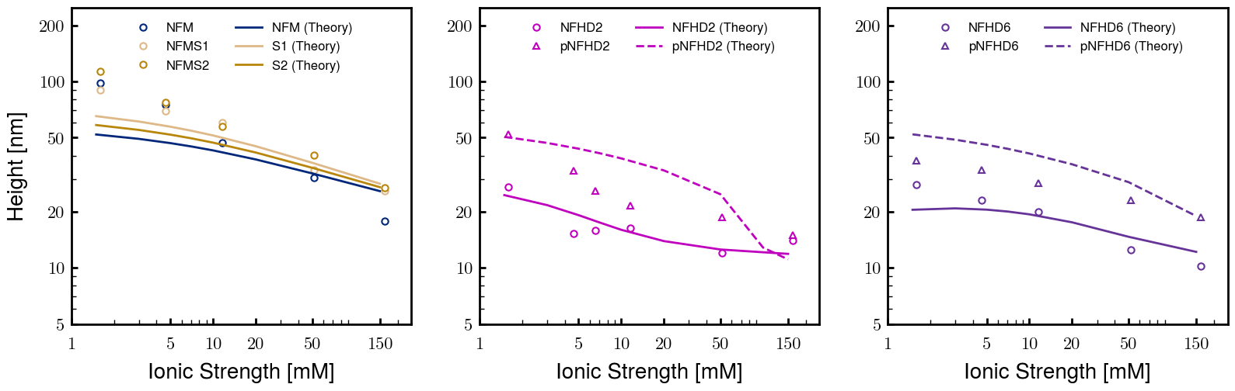
Agreement with AFM-measured heights
Unmodified
Modified
Chosen for best agreement with experimentally measured heights: $b=0.60 nm, ν=0.05 nm^{3}$. phospho H, $ν=0.15 nm^{3}$. Thresh $φ_{p}=1E−04$

Slide 8
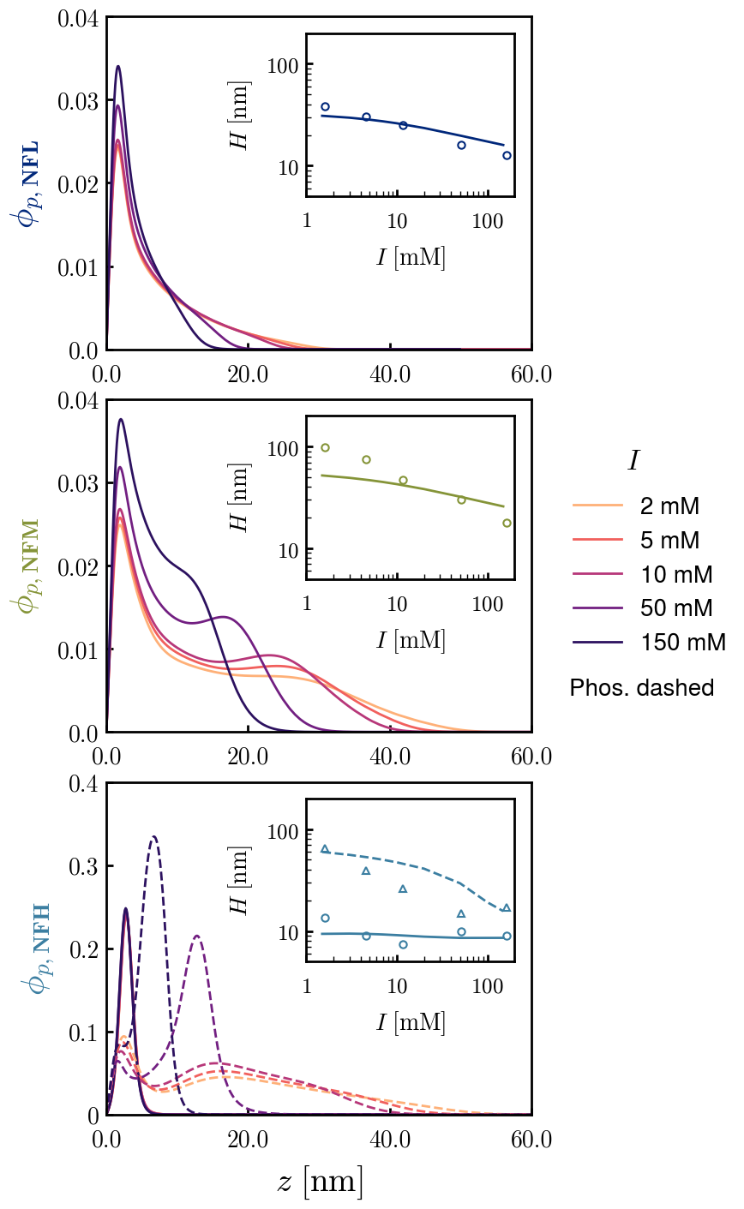
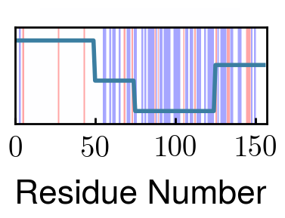
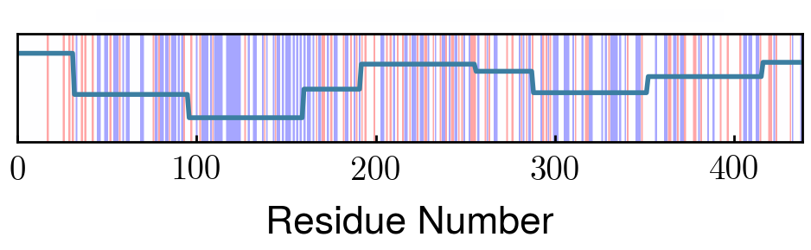
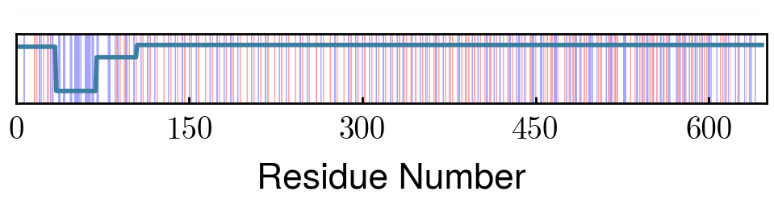
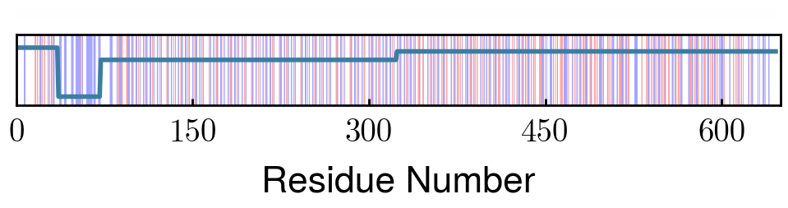
Effect of Sequence on Morphology (Unmodified proteins)
NFL
Progressively increasing charge distribution extends tail
NFM
Bimodal (peaks at Block 3 & 7) charge distribution creates shoulder
NFH
Non-phospho nearly net-neutral charge
Block 2 repels phospho. Block 3 (KSP units), preventing total collapse of outer layer
pNFH

Slide 9
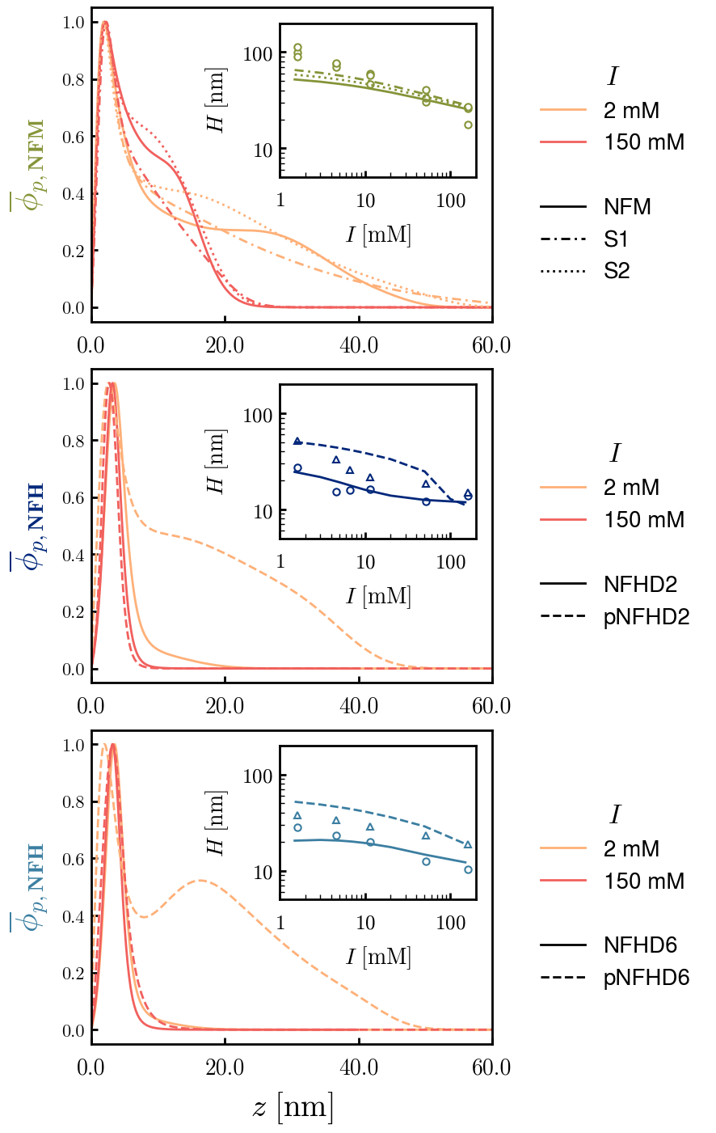
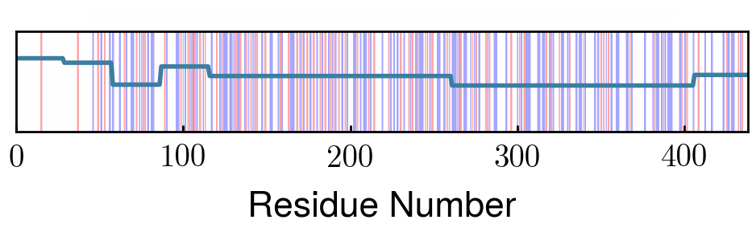
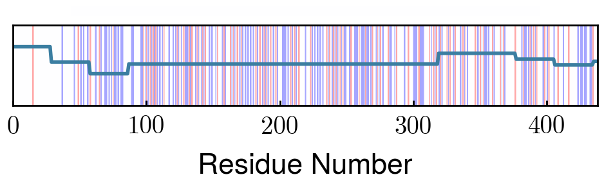
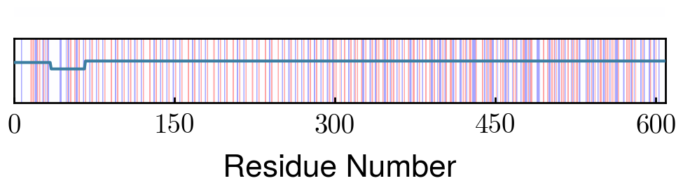
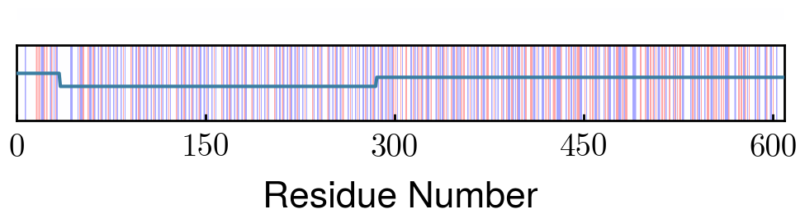
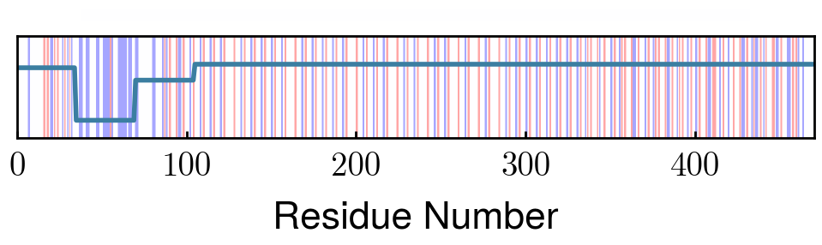
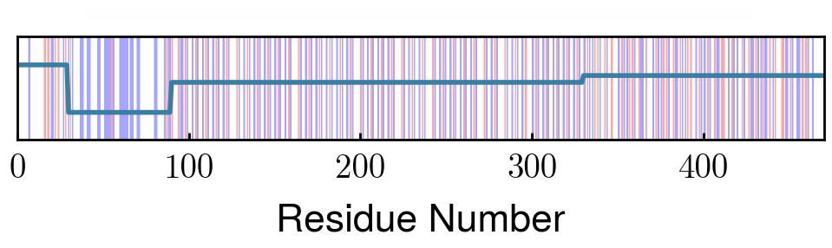
Effect of Sequence on Morphology (Modified proteins)
NFM
S1
Shuffled charge distributions lead to brushes with less prominent shoulders
S2
NFHD2
Deletion of Block 2 prevents shoulder in pNFH density at all ionic strengths (see prev. slide)
pNFHD2
NFHD6
Block 6 avg charge -0.01 ~ -0.02 (phospho)
pNFHD6
Deletion of Block 6 reduces neutralizing charge in NFH and repulsion in pNFH.
Densities normalized to compare different proteins on same plot

